Slide 1
eDocent
Group 5 - Iteration 2
Notes:
Ashley -

Slide 2
Overview
Iteration 2 Goals
Web App Testing and Demo
Android Application Demo
Iteration 3 Goals
Notes:
Ashley

Slide 3
Iteration 2 Goals
Museum user can create instance of art “object” and Android user can access collection
QR Reader on Android Phone
Registration
Stretch goals
Social Media Sharing
Map directions
Notes:
Ashley

Slide 4
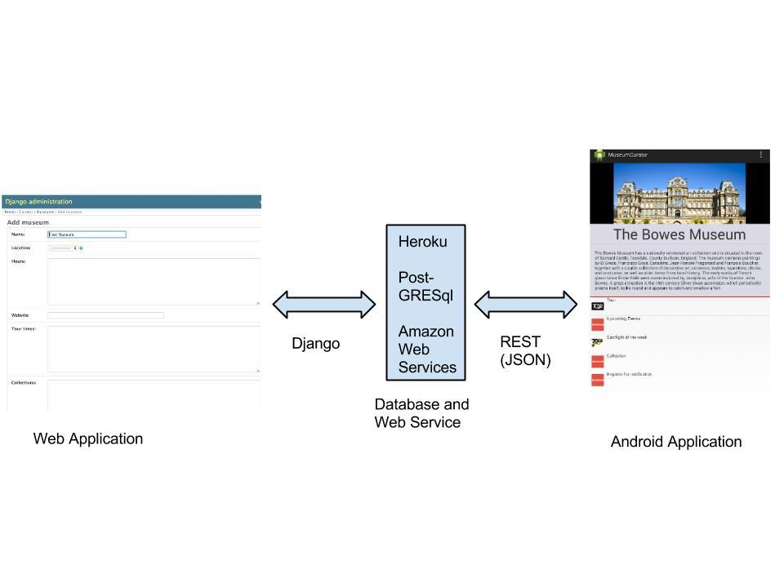
Notes:
Ashley - showed this in first iteration, now using heroku and amazon web services to host our static content

Slide 5
Backend - Registration
Signing up process
user visit/account/register
Filling the form
Clicking on submit button
Activating the account
Museum user: via email
Admin: manually after validation

Slide 6
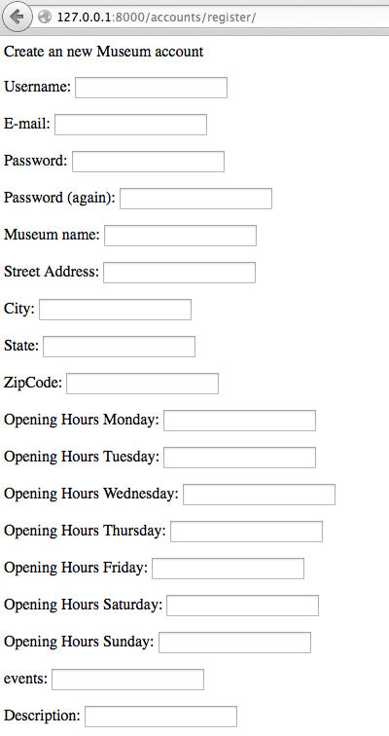
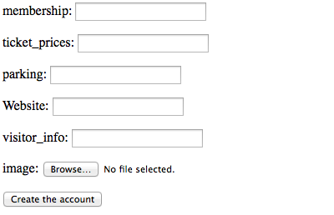
Backend - Registration
Registration Form (accounts)

Slide 7
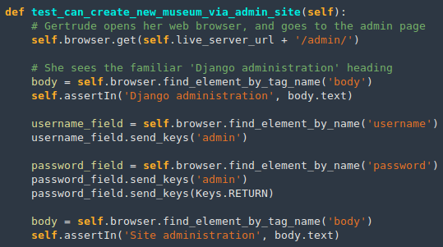
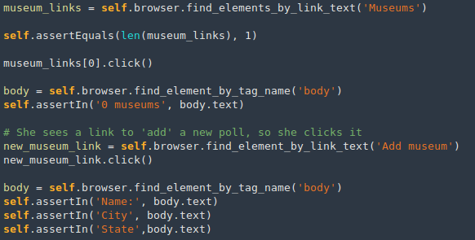
Testing with Selenium and Demo
Notes:
Casey

Slide 8
Creating an Art Object Demo
Creating and uploading associated image for art object
Creating a collection object for Android user to view
Notes:
Casey - will go to django page create art object, create exhibition to place art object

Slide 9
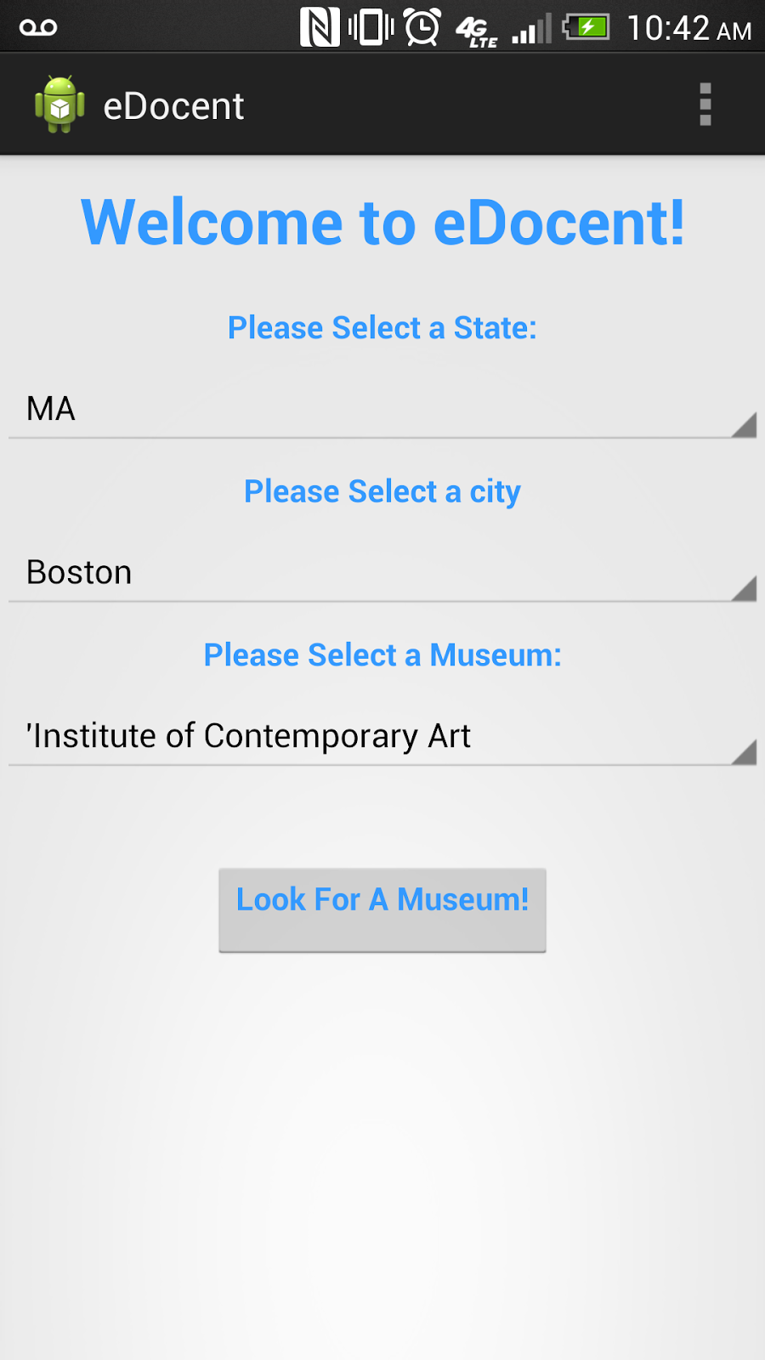
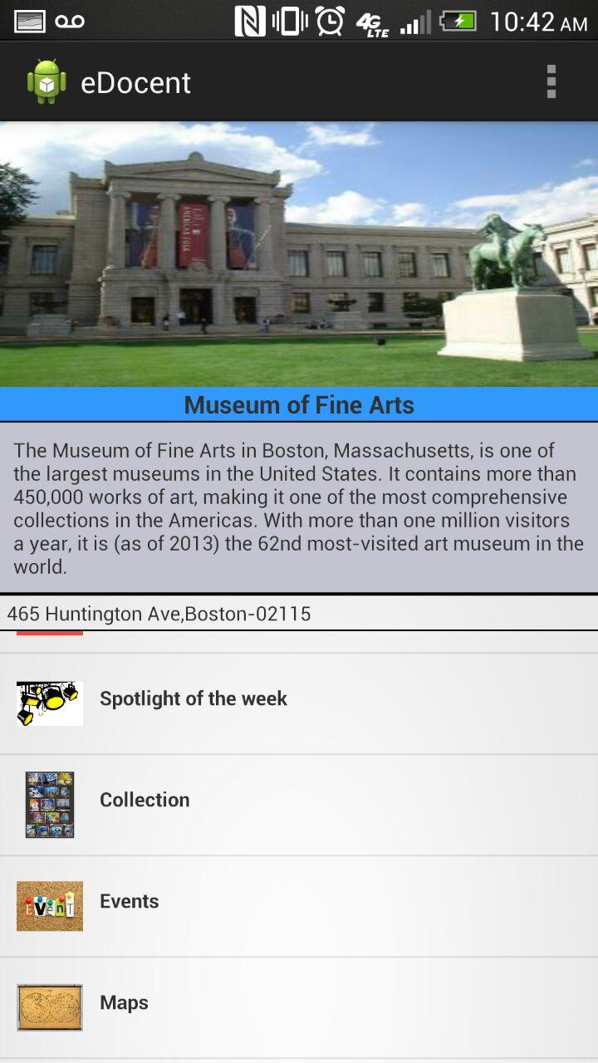
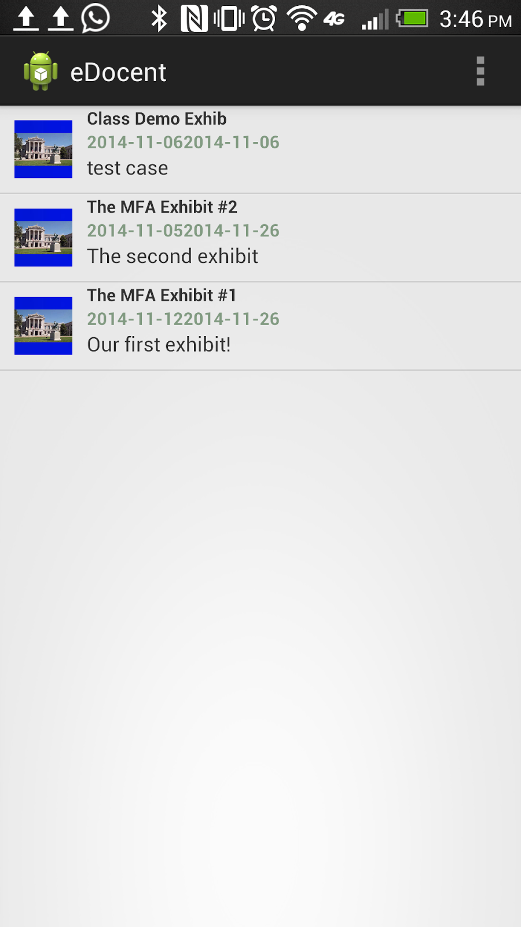
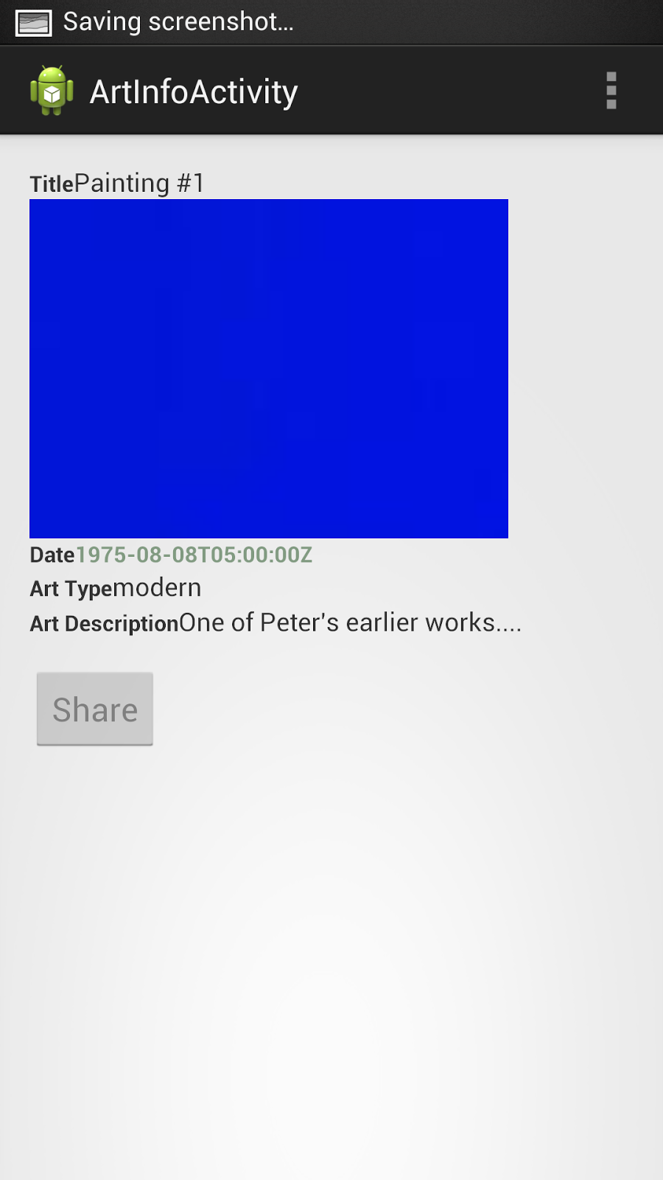
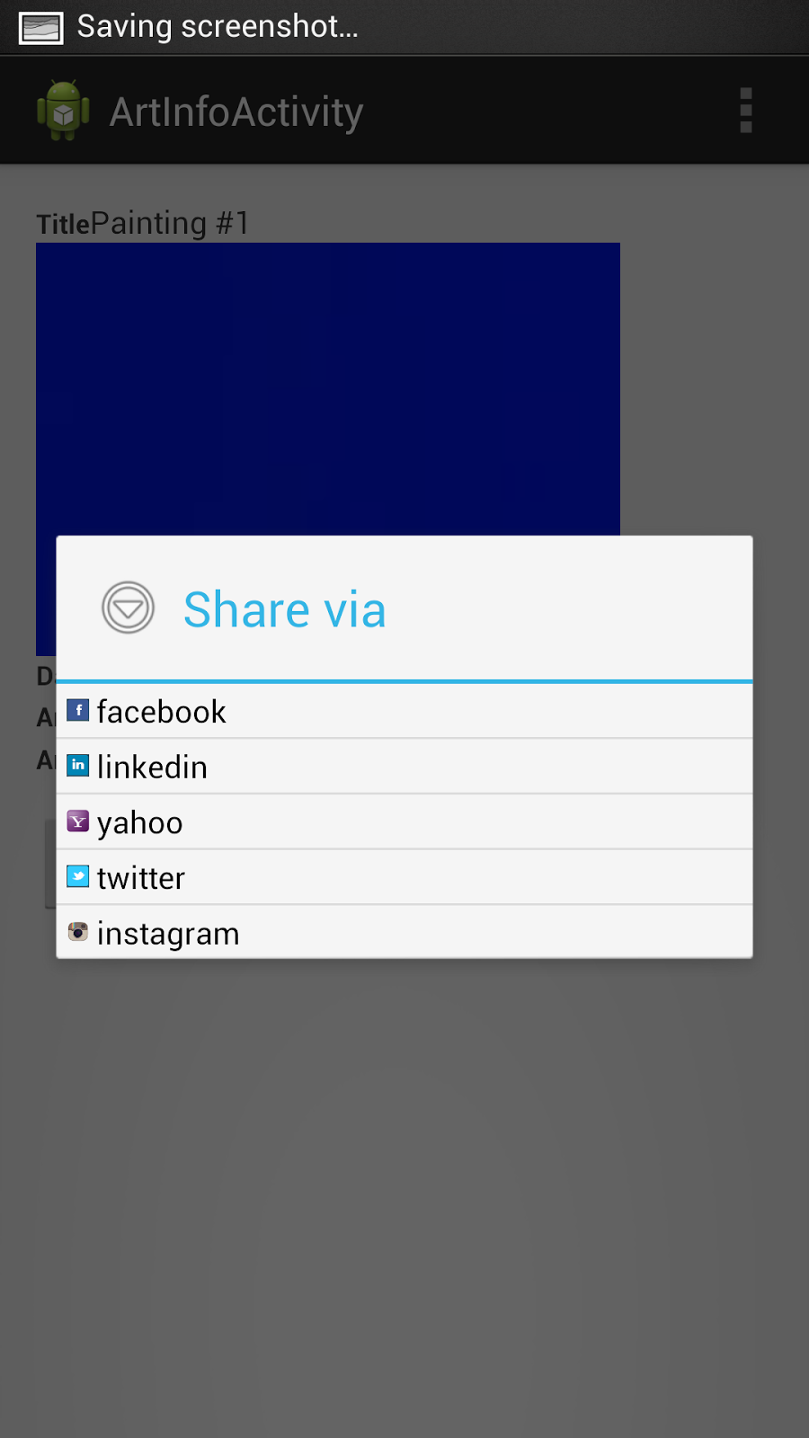
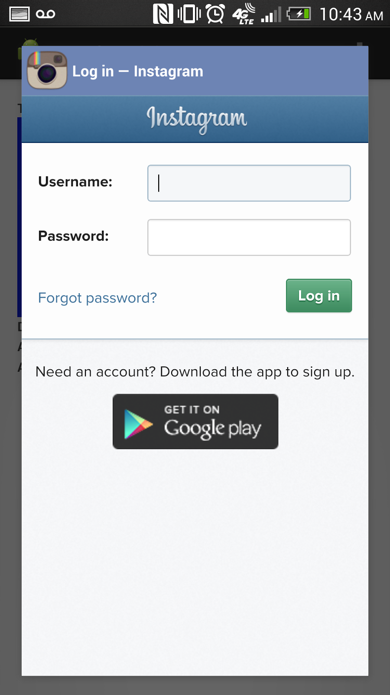
Android
Displaying collections of art objects

Slide 10
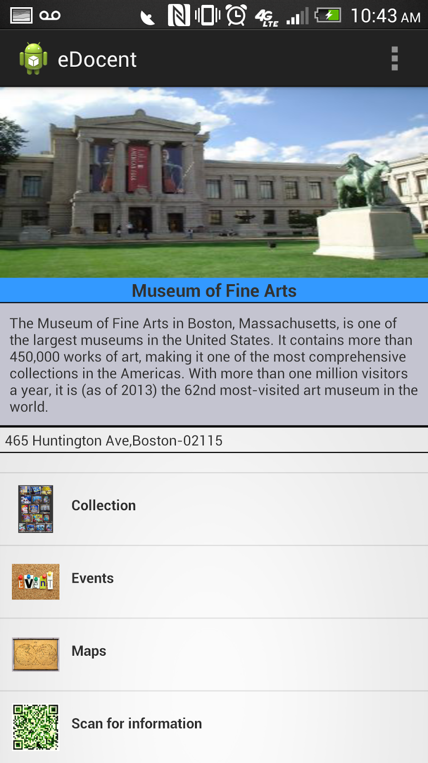
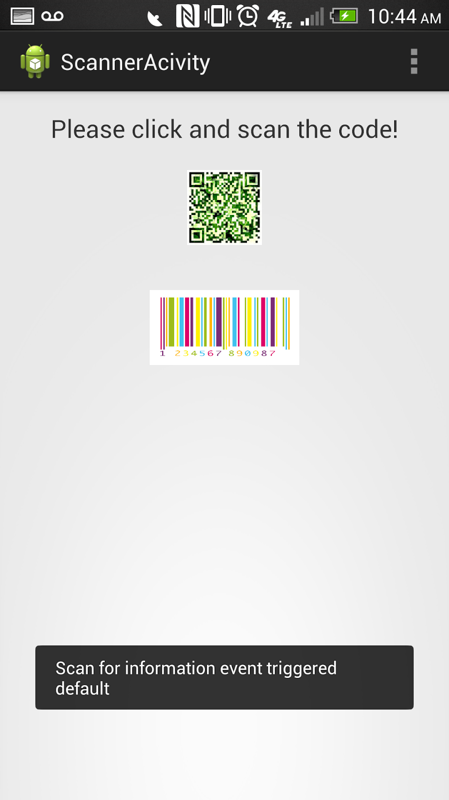
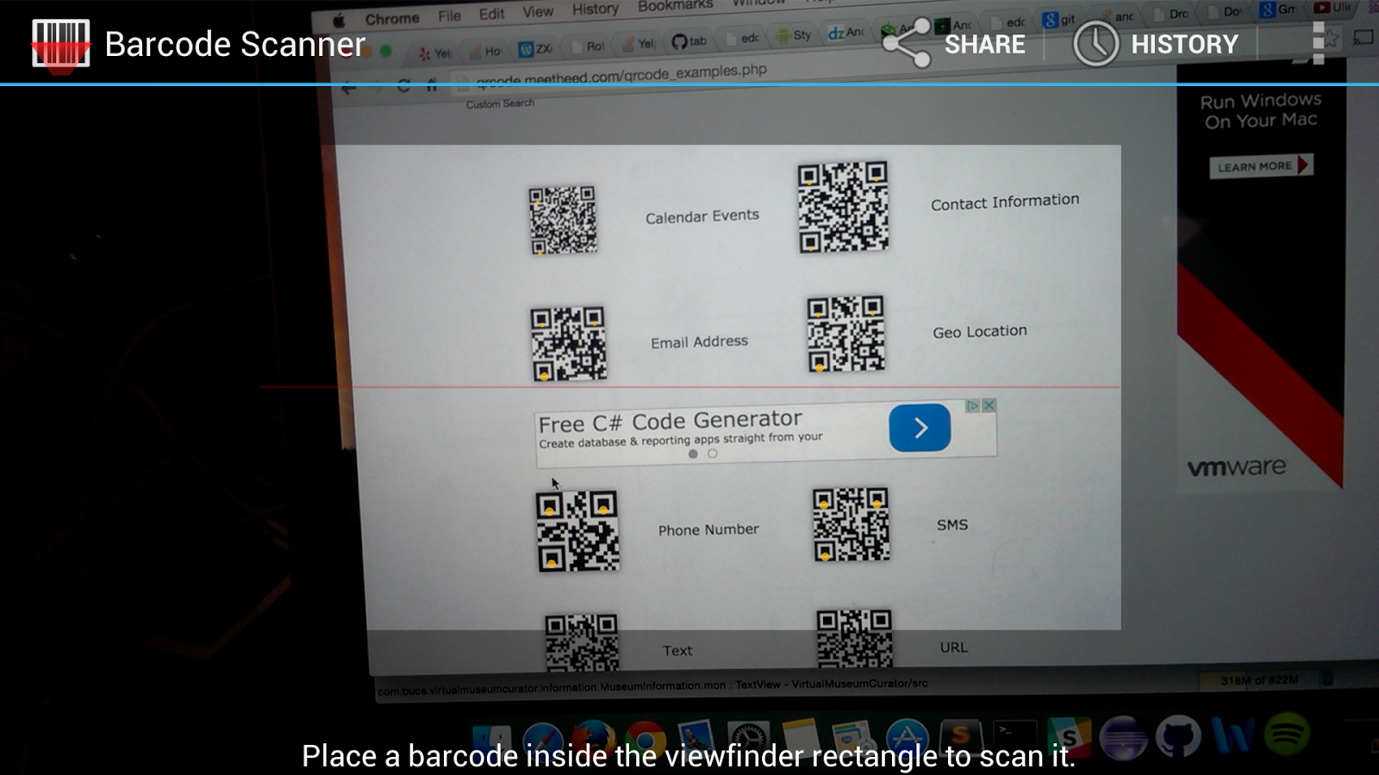
Android
The QR scanner

Slide 11
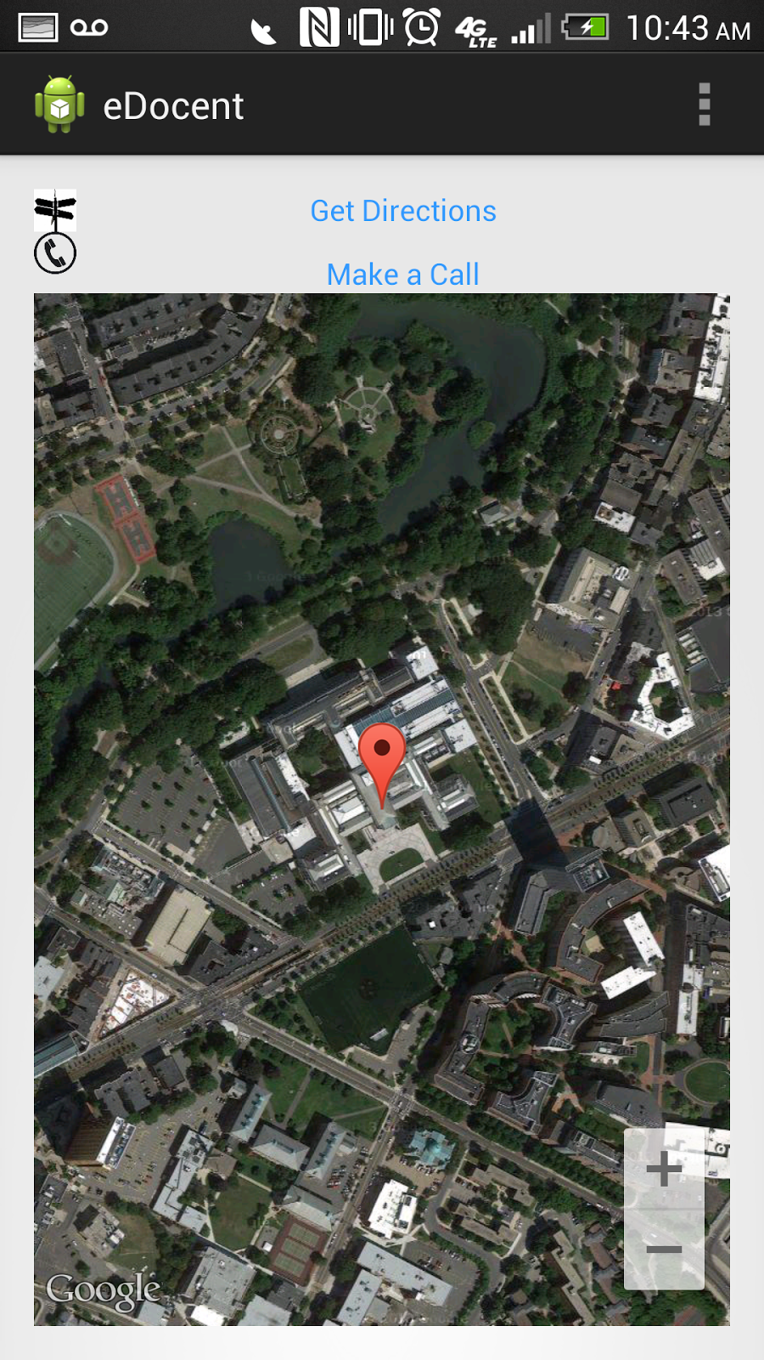
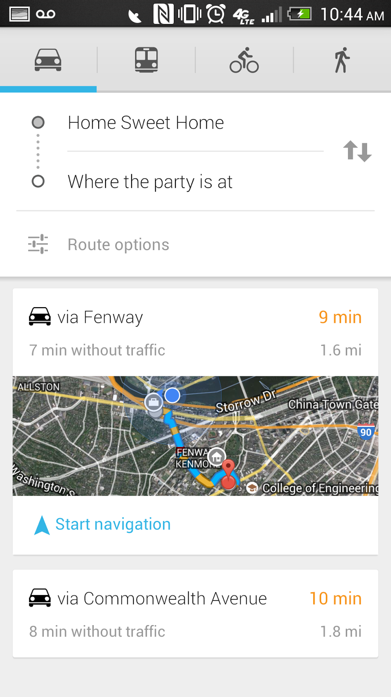
Android
Map and directions to the Museum

Slide 12
Android Demo
https://www.youtube.com/watch?v=jMxbKi5ARc0
zxing- A library which supports decoding and generating of barcodes (like QR Code, PDF 417, EAN, UPC, Aztec, Data Matrix, Codabar)
SocialAuth -Android SDK allows integrating with several social networks. This SDK contains the java libraries that do the OAuth as well as the REST calls for each social provider

Slide 13
Iteration 3 Goals
Get relevant images for museum home page and art work page
QR codes should directly lookup pieces of art
Complete testing

Slide 14
THANK YOU !

